Slide 1
Fraud Detection Model
Objective: To analyze historical transactional data to identify patterns and behaviours indicative of fraud.

Slide 2
Executive Summary
The goal of the project was to develop a fraud detection model capable of identifying fraudulent transactions in a financial dataset which contained the columns step, type, amount, nameOrig, oldbalanceOrg, newbalanceOrig, nameDest, oldbalanceDest, newbalanceDest, isFraud, isFlaggedFraud. To achieve this, different classification algorithms were applied to compare accuracy and check which is the most well-suited algorithm for our dataset and train the model to it. The dataset at hand are quite imbalanced with only a small proportion of fraudulent transactions which makes it difficult for the model to be perfect in detecting fraudulent transactions. Apart from accuracy score, it is also important to compare precision, recall, f1-score and auc score of the models.
My approach to this problem is to first perform data pre-processing, which involves data cleaning for missing values, feature selection, normalization etc, followed by creating data visualization to better understand the relationships between the variables and derive some insights into the data. Then follows model training for which I’ll start with logistic regression and then random forest and decision tree algorithm. On comparing the performance of the three models, we can determine which is more suitable to our project of detecting fraudulent transaction and our concerned dataset. The decision tree performed the best with an accuracy of ~0.9992, precision 0.89, recall 0.26 and f1 score 0.40. The performance of Logistic regression followed close behind with similar metrics and random forest model showed to poorest performance in all with a high accuracy and precision of ~0.9990 and 1.00 respectively but very low recall of 0.08 leading to an imbalance and thus the f1 score was 0.15. The results highlight the importance of balancing multiple performance metrics of a model and it is necessary to give equal importance to all metrics. There is room for improvement in terms of recall for all the models but it is also important to maintain a high precision too. We can further try much advanced algorithms to drive better results, however with the algorithms performed, Decision tree proved to better than the rest.

Slide 3
Problem
Logistic Regression
An online payment platform is facing increasing incidents of fraudulent transactions. The objective is to analyze historical transaction data to identify patterns and behaviors indicative of fraud. Using machine learning techniques, we have to train a fraud detection system that can flag suspicious transactions, thereby reducing financial losses and improving trust and security for legitimate users.
Models Used
Random Forest Algorithm
Proposed Solution
Develop a machine learning model to classify transactions as fraudulent or non-fraudulent suitable to our data and maximize precision and recall to ensure the model flags fraud accurately and minimizes overlooked fraud cases. To ensure this, plan of action requires following the data preprocessing procedure including techniques like handling missing values, feature engineering, normalization, etc. Then we’ll test multiple machine learning models and train them to the data to get optimal performance metrics.
Decision Tree

Slide 4
Model Fitting & Accuracy
The entire process can be broken down as follows:
Data Visualization
Correlation heatmap: This assisted to examine how all the key variables are related to each other.
Histogram: To explore the distributions of amounts and fraudulent transactions. It was found that most fraudulent transactions were of a smaller amount, probably since the fraudster was aware as to not raise suspicions.
Barplot: To compare the types of transaction affecting the transaction to be fraudulent or not. Cash out transactions were mostly found to be non-fraudulent while fraudulent transactions are either of transfer or cashout types.
2. Data Preprocessing
Label Encoding
Feature selection
Separation of features and target variable
Splitting dataset into training set and test set
Normalization of all columns
3. Model Training
Logistic Regression – Accuracy was 0.9991083136637818 and precision was 0.70 which means low false positives. However, recall, f1-score and AUC score were 0.22, 0.33 and 0.6097653516430921 respectively, which is poor and indicates an imbalanced dataset.
Random Forest – Accuracy was 0.9990606299024867 and precision was 1.00 which means the model is excellent in making correct predictions, however a low recall, f1-score and AUC score of 0.08, 0.15 and 0.5093457943925234 respectively, which means that the model is missing out on a lot of transactions that are fraudulent
Decision Tree – Accuracy was 0.9992084495625015 and precision 0.89 which is a great score for a model. Recall, f1-score and AUC score of 0.26, 0.40 and 0.6284879665330261 is slightly higher than the metrics of logistic regression model means that not only is the model better at predicting correctly but comparatively better in identifying fraudulent transactions.

Slide 5
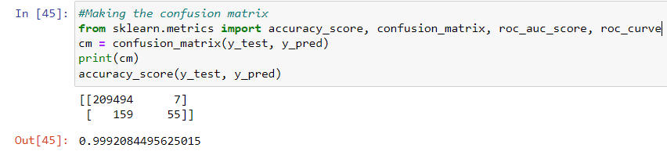
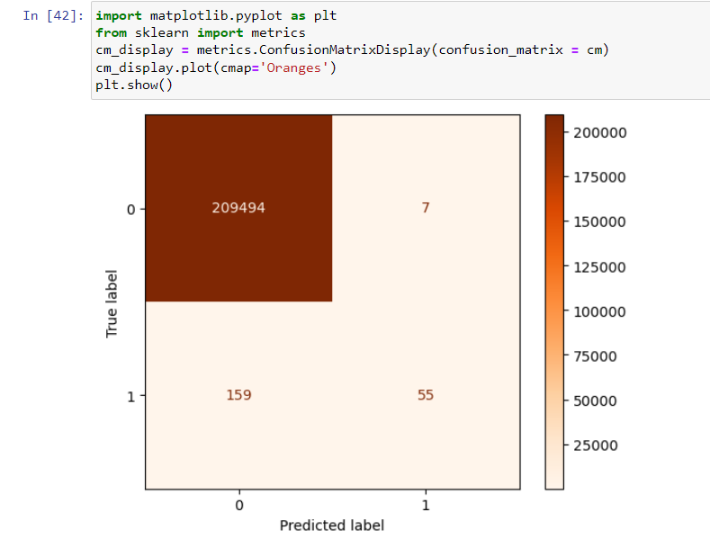
Code Snippets
Since the best accuracy was given by the Decision Tree model, here are a few snippets of the code.
Here, we created a confusion matrix to evaluate our model’s predicted values vs actual values and also printed the accuracy score. Confusion matrix depicts 209494 true positive values, 7 false positive values, 159 false negatives and 55 true negative values. This means that model fails to correctly classify 166 transactions.

Slide 6
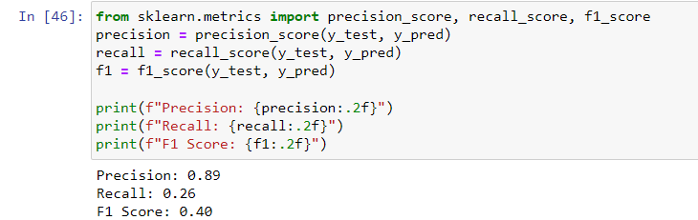
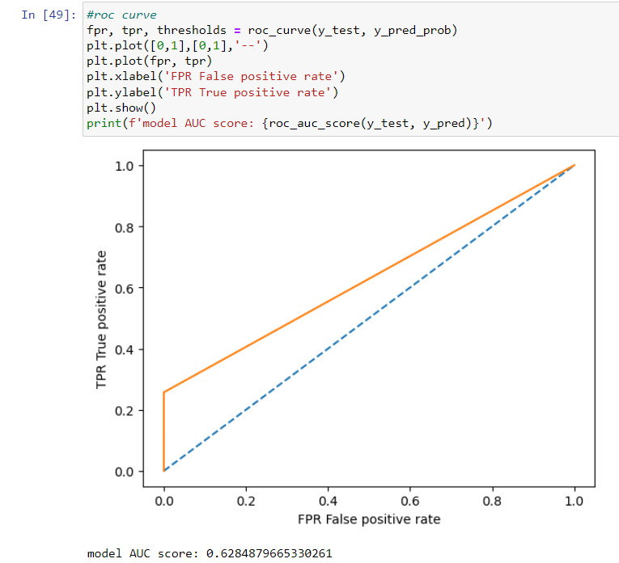
These codes are to calculate the precision, recall, f1-score, AUC score and to draw out the ROC curve for out model. The accuracy and precision is high which means that the model's classification is correct most of the time. The recall catches only 26% of the fraudulent cases. There is still scope of improvement in this case and F1 score too can also be further improved but shows a somewhat better balance between precision and Recall. AUC score suggests that the model has some ability to distinguish between fraudulent and non-fraudulent transactions but not highly accurate. The ROC curve depicts that the classifier's performance is better than a random classifier since the curve is above the random classifier line but is still not the best.
While our model has a good and accurate performance, improving the quality of the dataset and adding more datapoints of fraudulent transactions will help the model train better on the dataset and thus, not miss out on essential transactions.

Slide 7
Thank You!

